Slide 1
Genetic Markers for Tregs
09/02/2020

Slide 2
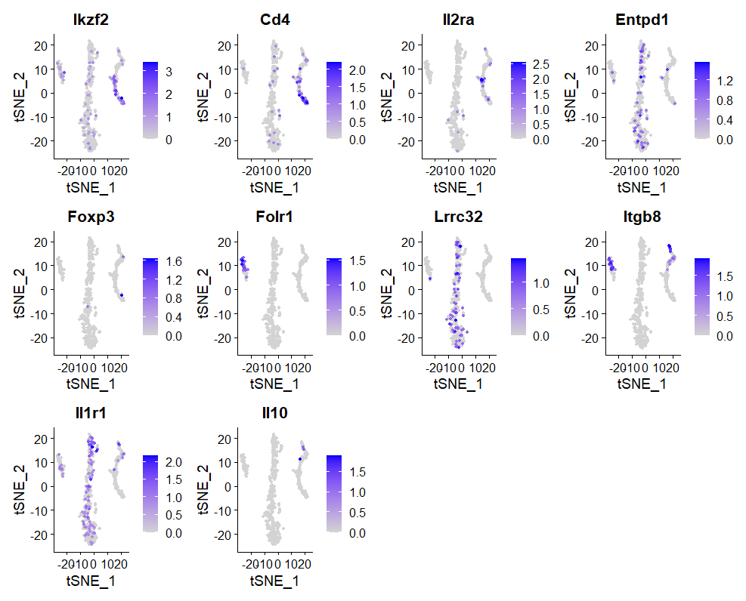

Slide 3
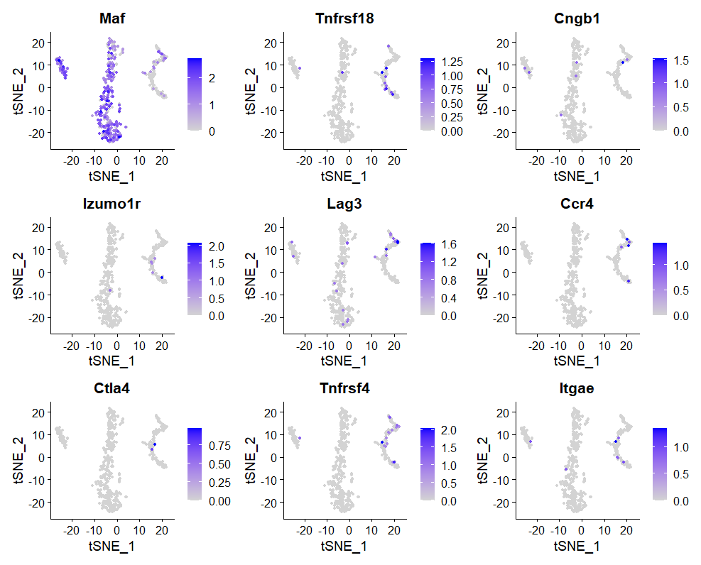

Slide 4
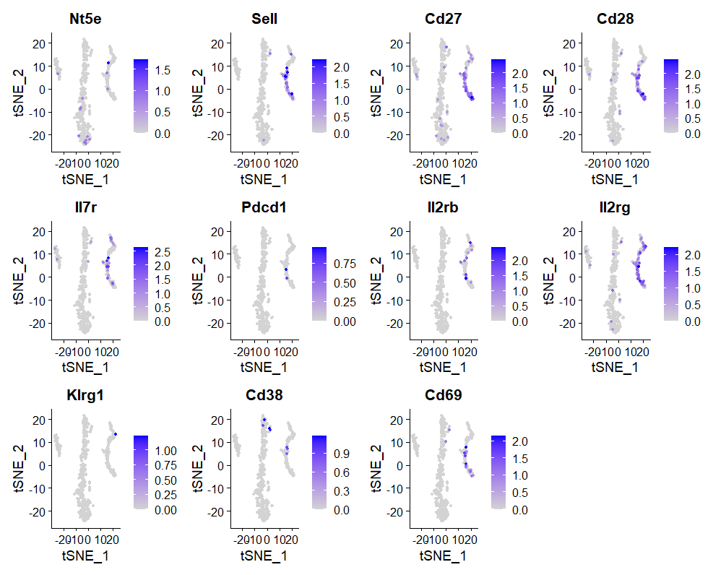

Slide 5
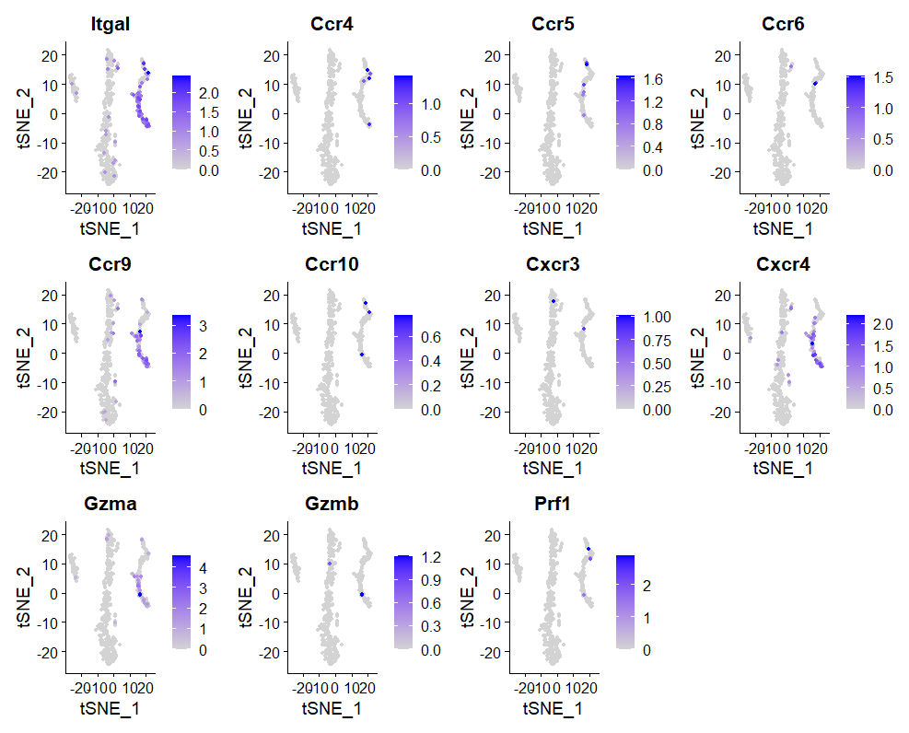

Slide 6
Summary from R Data Analysis Where did the gene expression end up the most?
Left
Center
Right
All over
Unremarkable
Folr1
Itgb8
Entpd1
Lrrc32
Il1r1
Cd4
Il2ra
Tnfrsf18
Tnfrsf4
Sell
Cd27
Cd28
Il7r
Il2rb
Il2rg
Cd69
Itgal
Ccr4
Ccr5
Ccr9
Cxcr4
Gzma
Ikzf2
Maf
Lag3
Foxp3
Il10
Cngb1
Izumo1r
Ccr4
Ctla4
Itgae
Nt5e
Pdcd1
Klrg1
Cd38
Ccr6
Ccr10
Cxcr3
Gzmb
Prf1

Slide 7
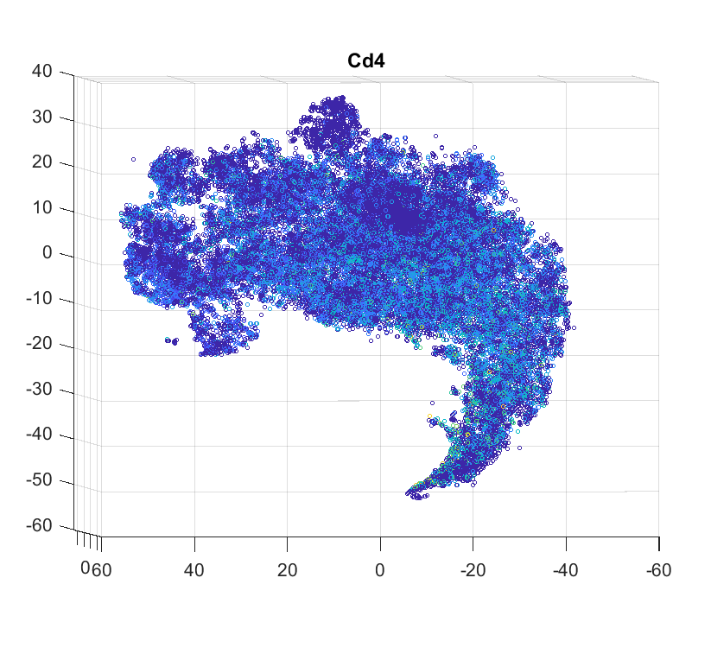

Slide 8
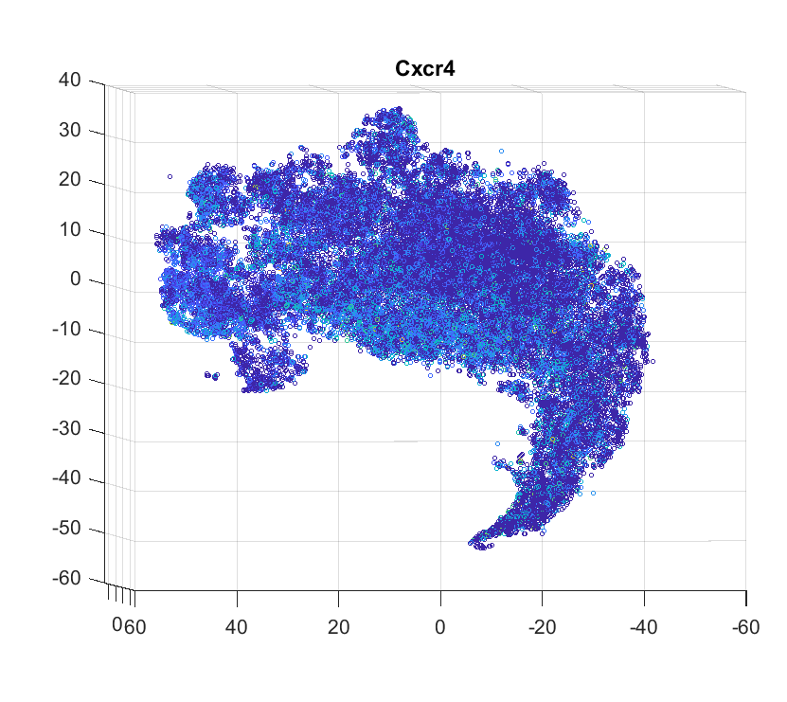

Slide 9
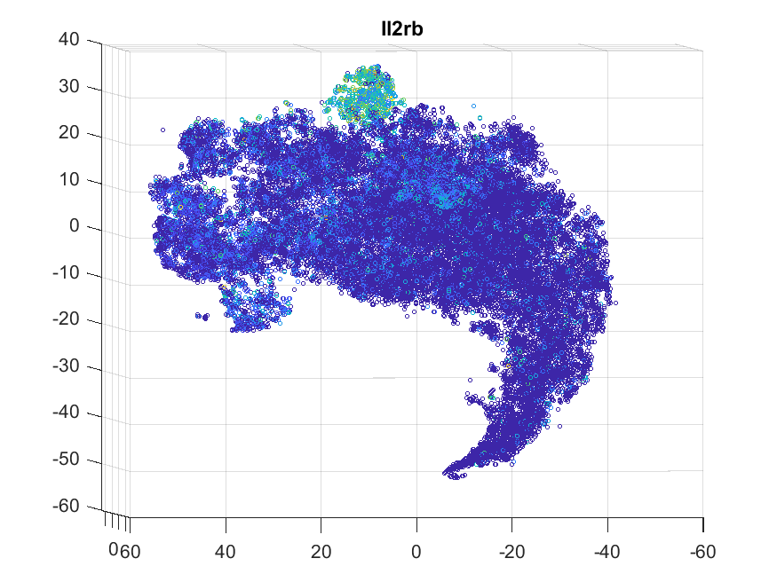

Slide 10


